Slide 1
Comparison of Methods for Capturing Material Discontinuities
With an Introduction to GPU Programming
Sean Davis and Will Matern

Slide 2
Acknowledgements
Mentor: Dr. Bob Robey
Workshop Coordinator: Dr. Scott Runnels
Collaborator: David Nicholaeff
Thank you!

Slide 3
Outline
Motivation
Discontinuities
Problems observed in numerical methods
Description of methods reviewed
Lax-Wendroff with limiters
MPDATA
MUSCL
SUPG
Results
2D Advection Equations
GPU Programming
Conclusions

Slide 4
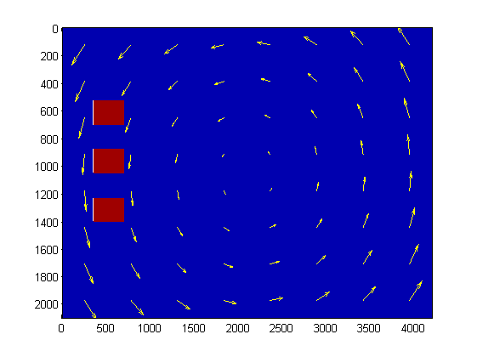
Motivation
A simple model problem showing the advection of radioactive

Slide 5
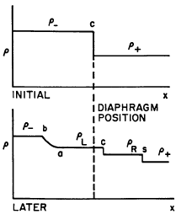
Contact discontinuities
A discontinuity that occurs in density but other quantities like pressure, velocity, and specific internal energy are continuous.
From Harlow and Amsden - “Fluid Dynamics”

Slide 6
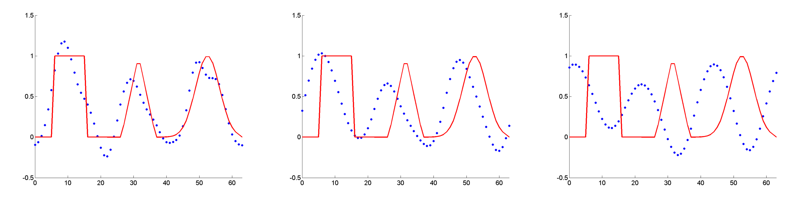
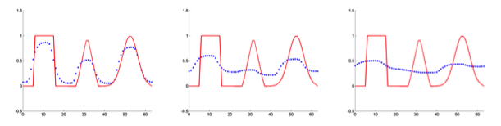
Problems observed in numerical methods for equations with discontinuities
Oscillations – High Order schemes
Ex) Lax-Wendroff
Large dissipation – First Order Schemes

Slide 7

CFL condition
Related to information propagation.
Numerical solution should not move faster than analytic.
This means:
For some methods CFL = 1 means a perfect propagation speed.
Easy proof that Lax-Wendroff and Upwind converge to the exact solution when CFL =1.

Slide 8
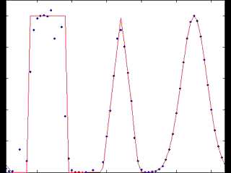
Descriptions of methods reviewed
Lax-Wendroff w/o Limiters
Conservative 2nd order scheme
Approximate solution has oscillations around sharp gradients

Slide 9
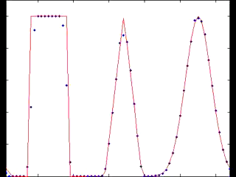
Description of methods reviewed
Lax-Wendroff w/ Limiters
1st order near discontinuities, 2nd order elsewhere
For linear equations is mathematically guaranteed to be TVD

Slide 10
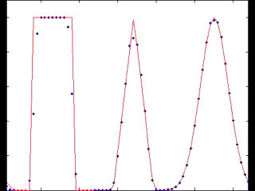
Description of methods reviewed
MUSCL
ACM – Slope limiter method for sharpening discontinuities.

Slide 11
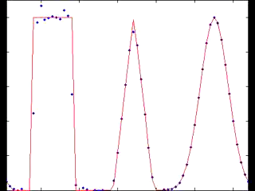
Description of methods reviewed
Streamline Upwind Petrov-Galerkin (SUPG)
Finite Element approach
Inspired by finite difference methods (upwinding and artificial diffusion)
Applies to linear advection/diffusion equations of any dimension
Is neither TVD nor conservative

Slide 12
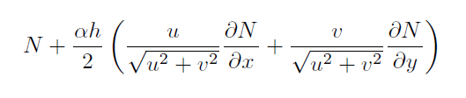
Theory of the Streamline Upwind Petrov-Galerkin (SUPG)
Trial functions – a set of functions assumed to approximate the underlying solution. The trial functions have degrees of freedom that must be solved for.
Test functions – a set of functions used to solve for the degrees of freedom of the trial functions. Uses the weak formulation of the governing equation.
Petrov-Galerkin – Test functions ≠ Trial functions
SUPG – Choose test functions to be:
where N is a trial function

Slide 13
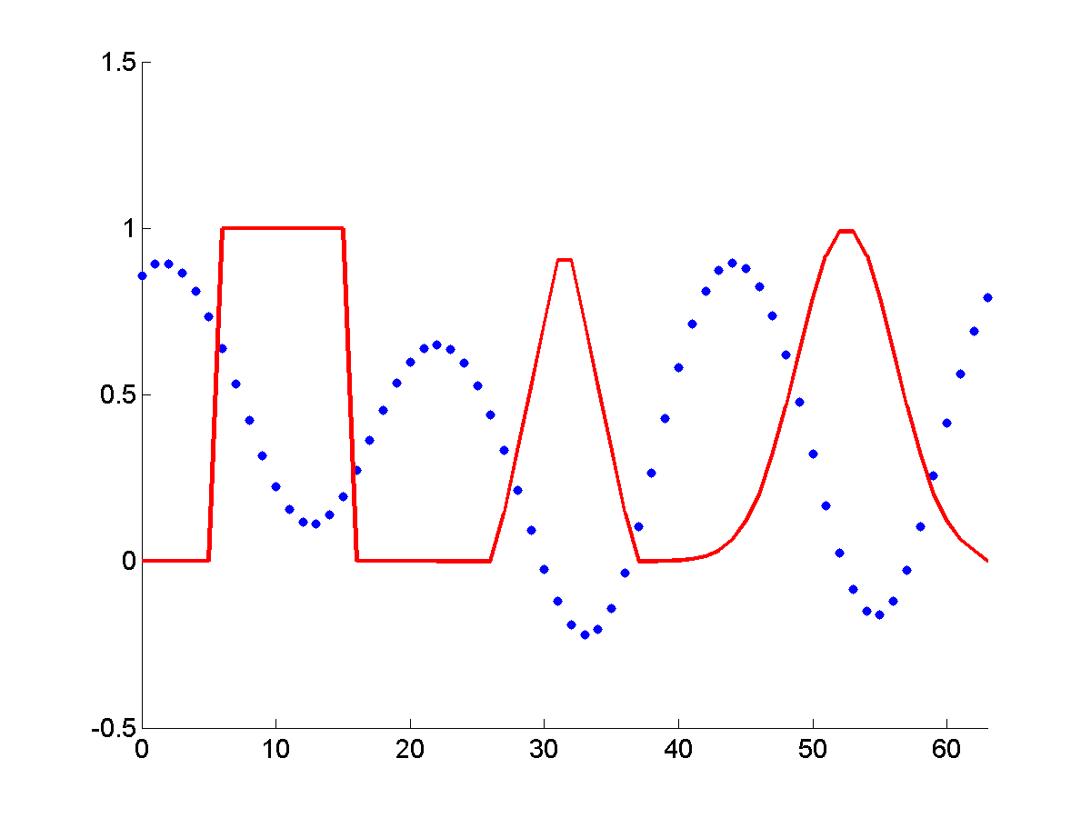
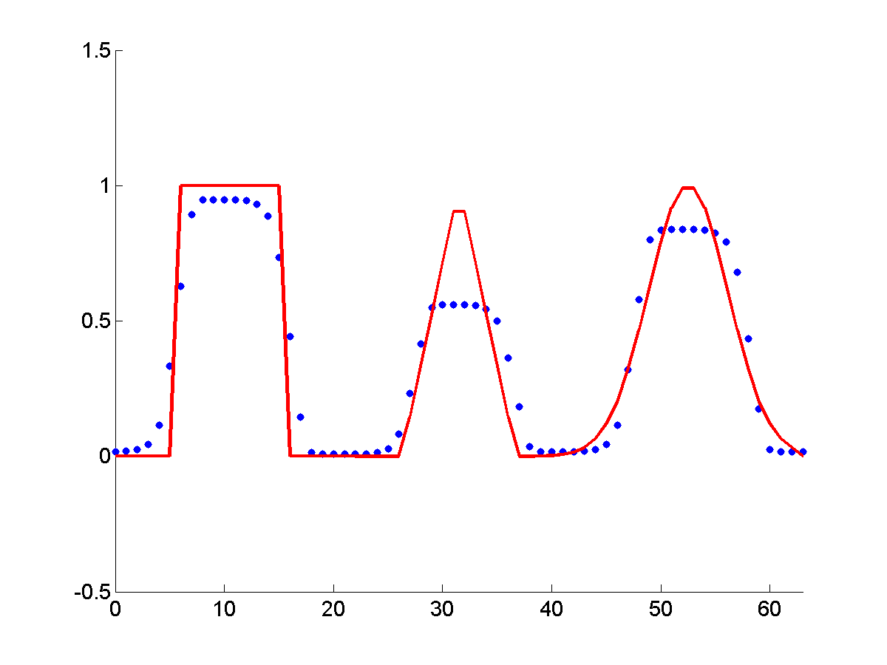
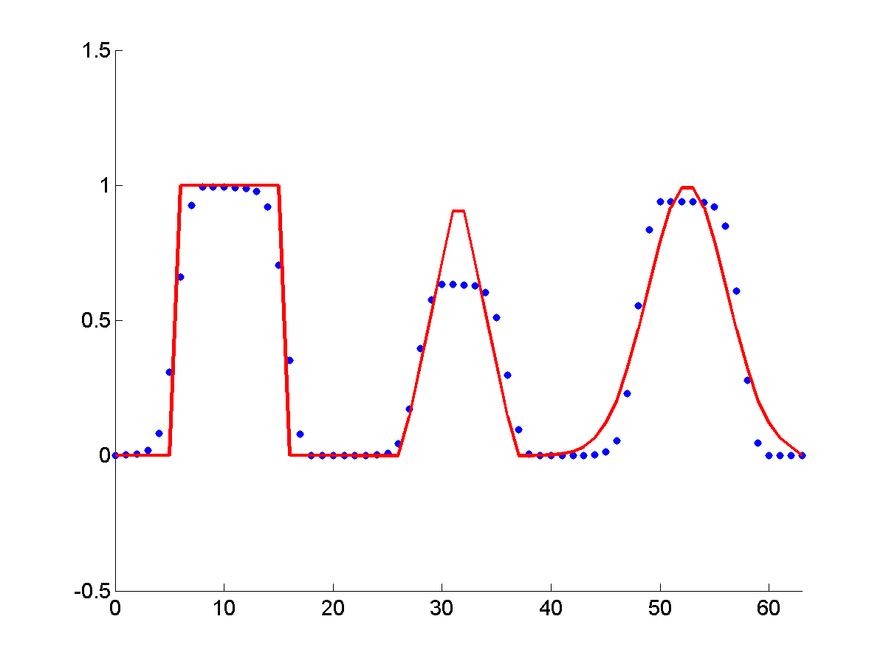
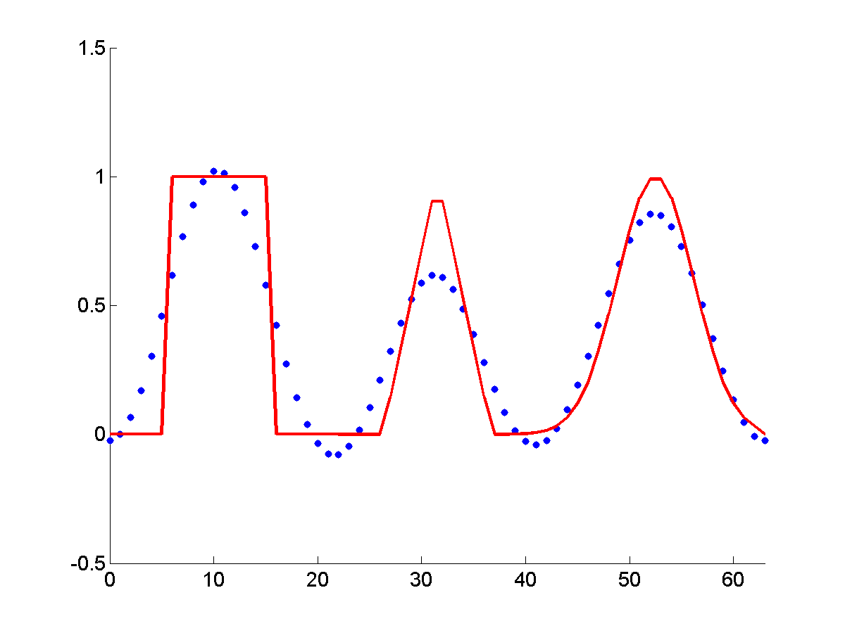
Results for 1D Advection in a 2D Code after 10 Periods
Lax-Wendroff (not TVD):
Lax-Wendroff (Superbee):
MUSCL:
SUPG:
Notes:
Only show the last column.

Slide 14
2D Wave Advection Test Conclusions
Lax-Wendroff with slope limiters
Effective for sharp discontinuities
Overly dissipative for thin waves (cuts off the top of the triangular/gaussian waves)
more dissipative than other methods
MUSCL with ACM
most effective for problems with discontinuities
Unnaturally sharpens the solution
SUPG
Balances well between diffusion and discontinuity sharpness
Doesn’t introduce unnatural sharpening
Requires matrix operations
Non-conservative

Slide 15



Derivation of Lax-Wendroff for advection equation
Advection Equation:
Note that:
Replace the first two time derivatives with spatial derivatives
Remove 3rd order terms and above, and use central difference formulas:

Slide 16
Limiters
Godunov’s Theorem – Any linear scheme above first order accurate (space) cannot be Total Variation Diminishing (TVD).
First order methods – often lead to large numerical diffusion
Solution: Limiters (a nonlinear scheme)
First order at discontinuities
Higher order where solution is smooth
For certain linear problems can be shown to be TVD.

Slide 17
MPDATA - Derivation
MPDATA
One-sided bias donor cell approach
Using a modified equation analysis, find an extra diffusive term
Subtract out diffusive error using an anti-diffusive velocity

Slide 18
MPDATA - Conclusions
MPDATA
Options to control total variation (FCT) and

Slide 19
GPUs at a glance
Much higher FLOPS (floating points operations per second) per dollar than CPUs.
Different architecture from a CPU.
Many low throughput processing units
Cores on the same card have shared global memory
Warp/Wavefront- Similar to vector processor except much larger (SIMD)
Must use a language compiled for GPU
OpenCL – Open programming language that can make use of multiple CPUs (on the same node) and a GPU. Can combine with MPI for multiple nodes.
CUDA – Nvidia only.
This Project: OpenCL

Slide 20
GPU architecture
Global Memory
Available to entire device
Local Memory
Available to the work group only
***I think this isn’t well defined in OpenCL and can spill over to Global without warning
Private Memory
Available to work item only
Constant Memory
Read only, can be faster than global
SIMD group size – efficient code is a multiple of this
Nvidia – Warp = 32 cores
ATI – Wavefront = 64 cores
http://stackoverflow.com/questions/7093488/opencl-how-to-i-query-for-a-devices-simd-width

Slide 21
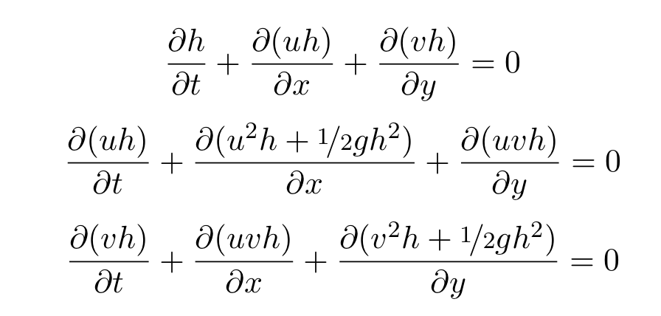
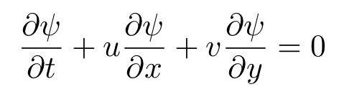
Shallow Water Equations
Simplification of the Euler Equations
Uniform Fluid Density
Wavelengths are much longer than fluid depth
Inert Tracer Equation

Slide 22
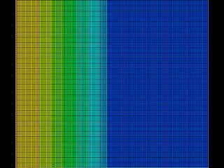
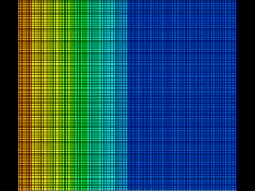
Shallow Water Simulations on the GPU
Fluid Height
Inert Tracer Concentration

Slide 23
Future Directions
FEM approach for full Euler equations
Implement schemes for advection on the GPU (include in CLAMR)
Implement these schemes to solve the full Euler Equations
Alternative numerical methods (WENO, Discontinuous Galerkin, etc.)

Slide 24
Question, Comments, Suggestions?

